Slide 1
Liminal Spaces and the Uncanny Valley:
An Interdisciplinary Virtual Reality and Psychology Experimental Research Design
Ethan Wang, James Kerrane, Vincentius Aaron Chen
Notes:
Do Introductions on this page

Slide 2
Acknowledgements
Robert Hettmansperger (CS mentor)
Carla Flanhoffer (Qualified Scientist)
Ilse Meiler (SRS/writing/science fair mentor)

Slide 3
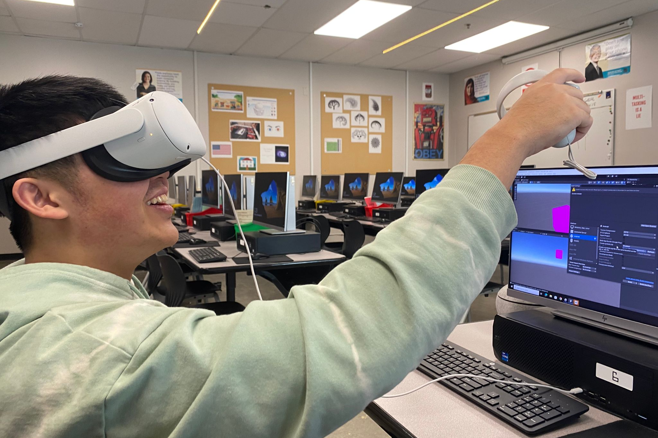
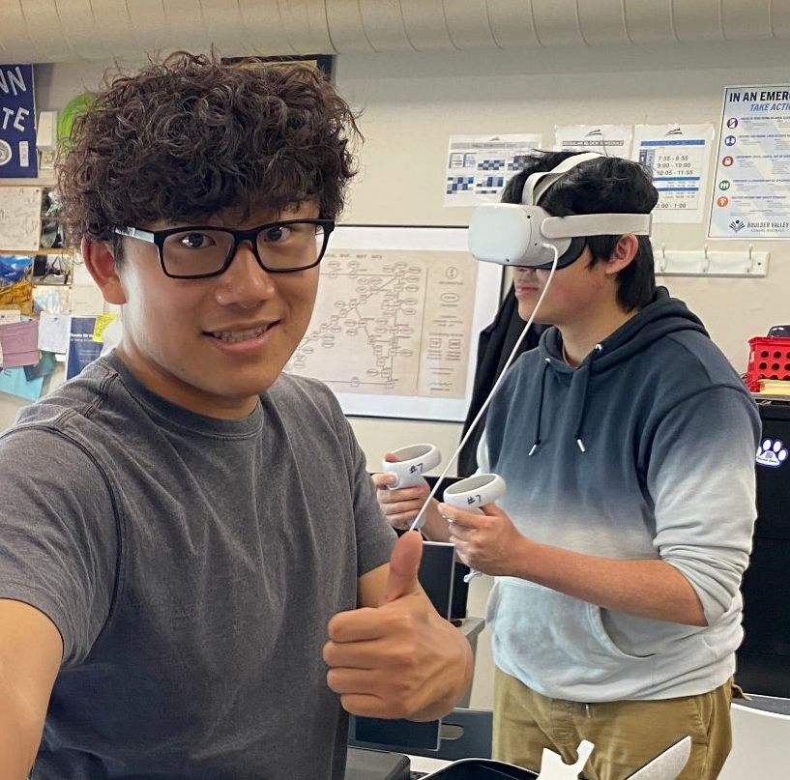
Project Overview
What are Liminal Spaces?
How are we using VR in this experiment?
What have we done to prepare for implementing this project?
What will the project look like/how will we collect data?

Slide 4
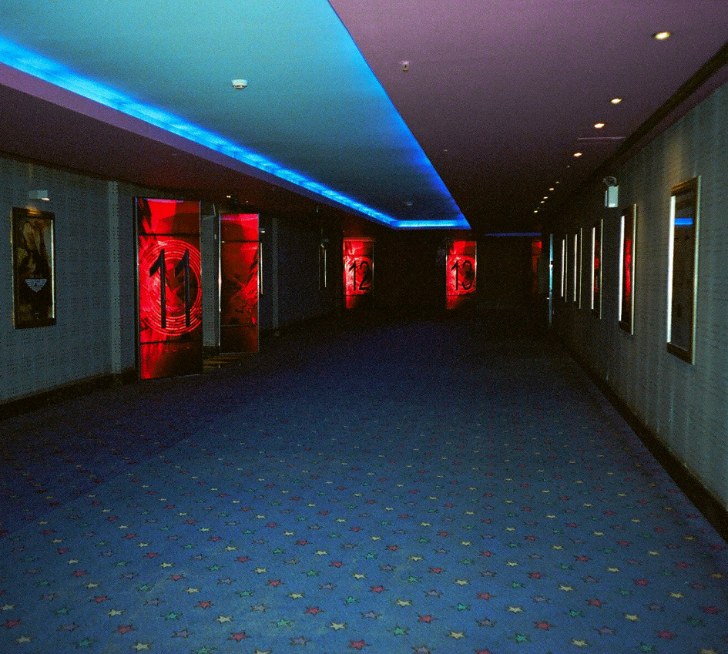
In Class Research Design Pitches
Research design brainstorming in class
Top pitch selection process
Reason for selecting liminal spaces
In class data collection

Slide 5


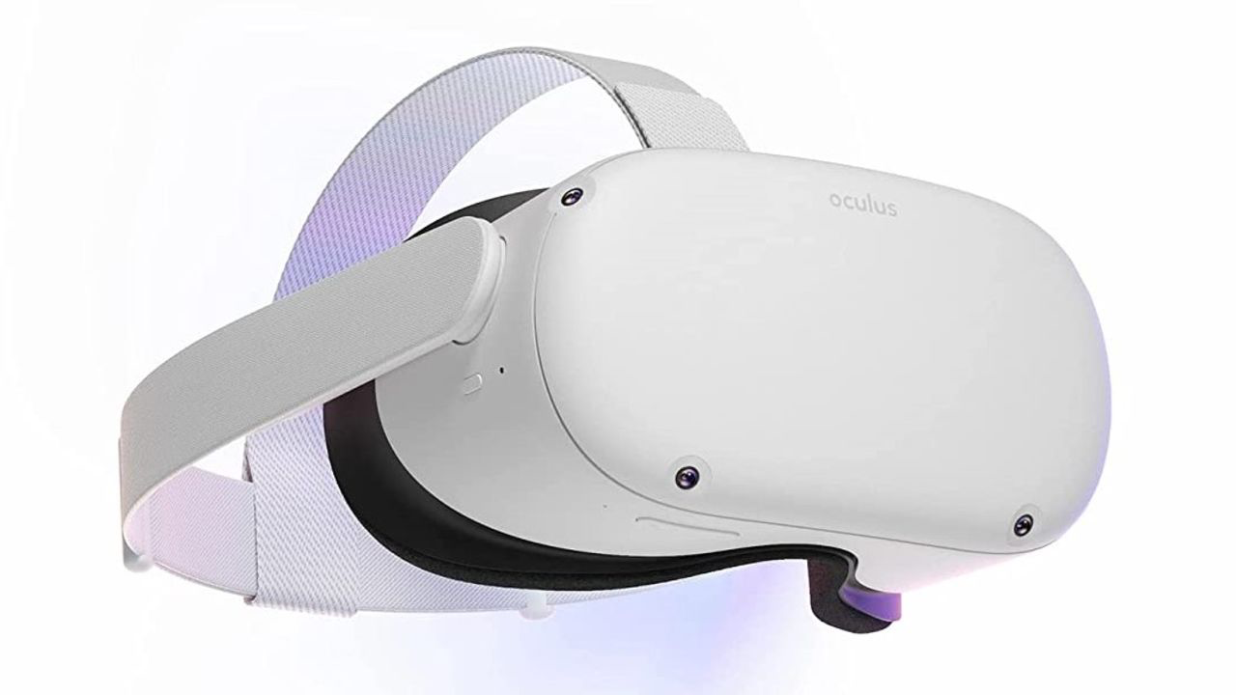
CDIP Grant
Career development and AP class enhancement
CDIP Grant
  10 VR Headsets
  Industry-Standard Unity Certifications

Slide 6
Research Question
How do the different orientations/organizations of objects within a space affect the comfort of those occupying that space?

Slide 7

Building in the Unity Game Engine

Slide 8



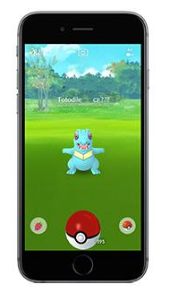


All made with Unity? sus…

Slide 9
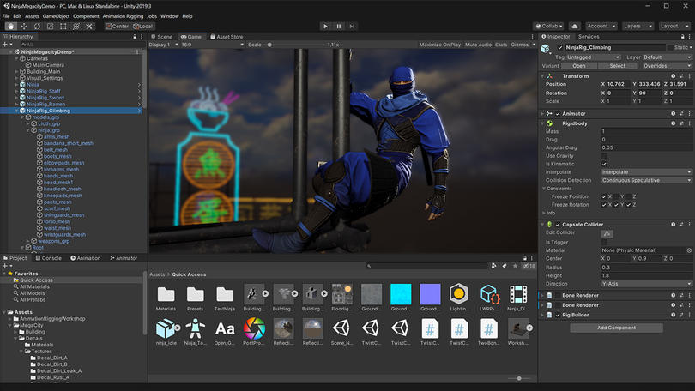
what we've been staring at for the past year

Slide 10


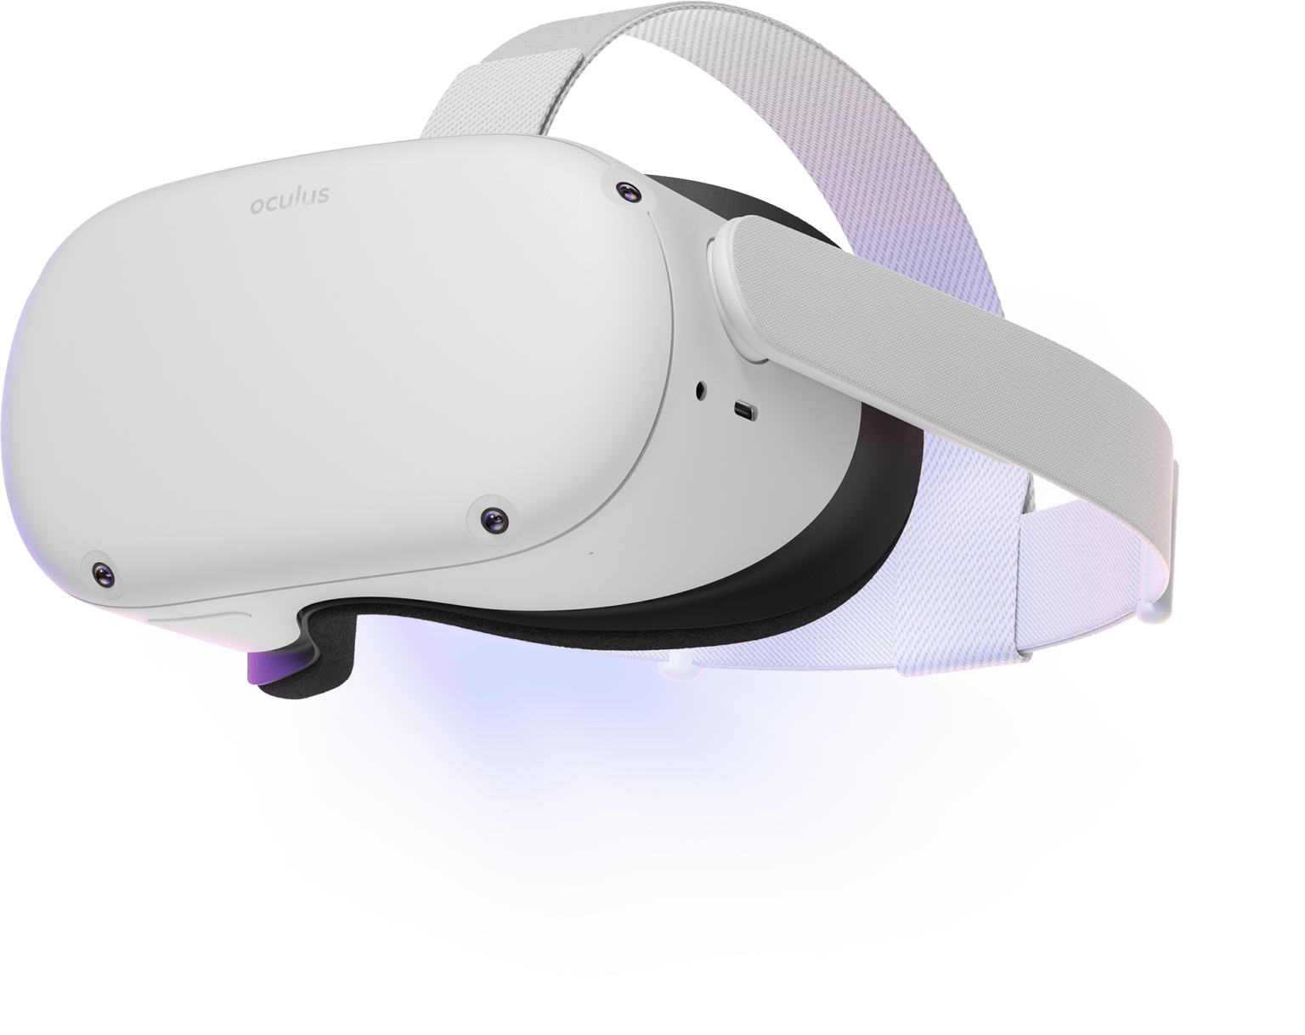

FRAMEWORK: Project Architecture
Custom C#
Code
Virtual Reality
Headset
Experiment Server
(Database)

Slide 11
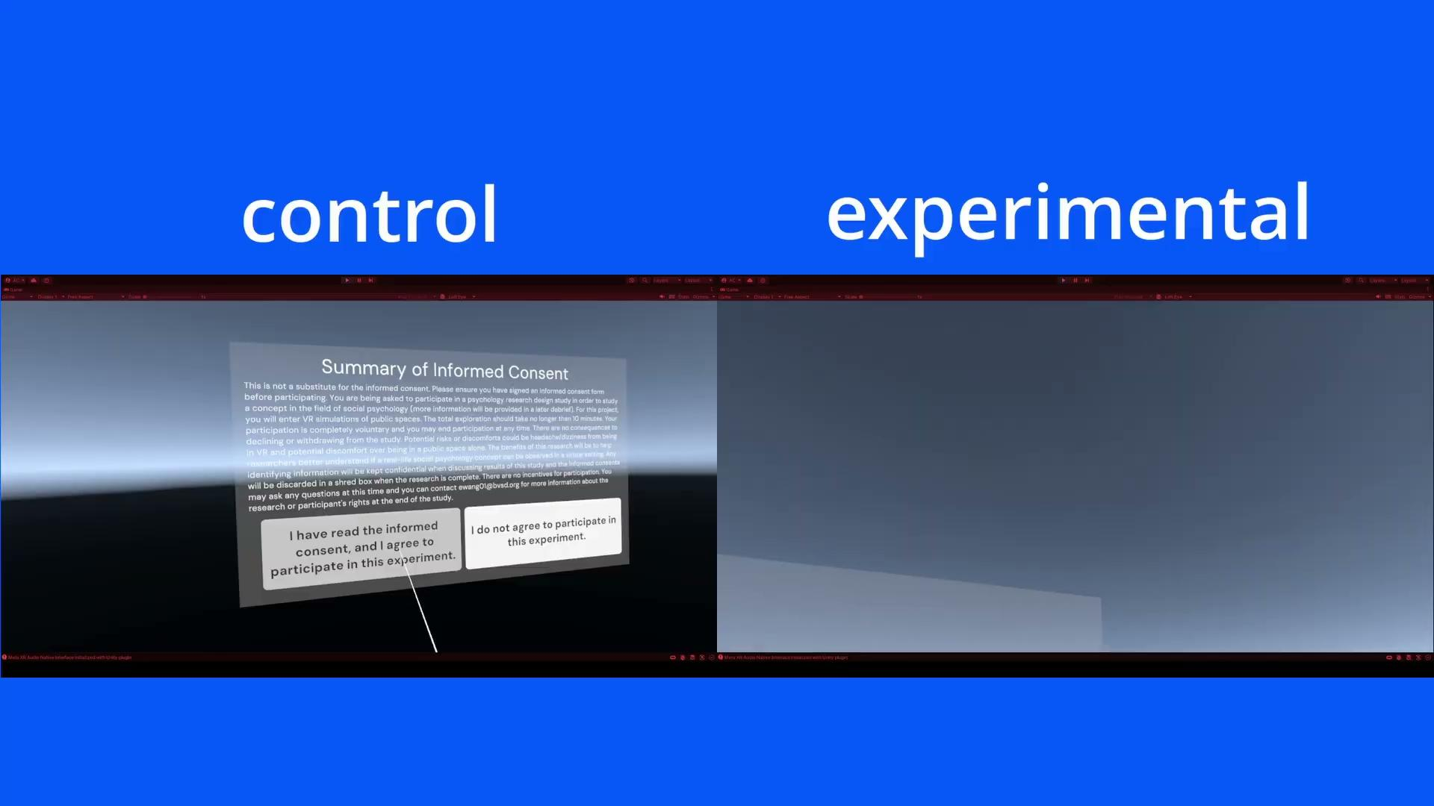
FRAMEWORK: Liminal Spaces + Quantitative Results
By turning common environments into a liminal space–often associated with spaces that cause some sort of discomfort or unease (Mauro, 2021)–unease can be measured quantitatively with the amount of time someone spends in a room before moving onto the next room, and with the qualitative results of a post-experiment survey.

Slide 12
Findings

Slide 13
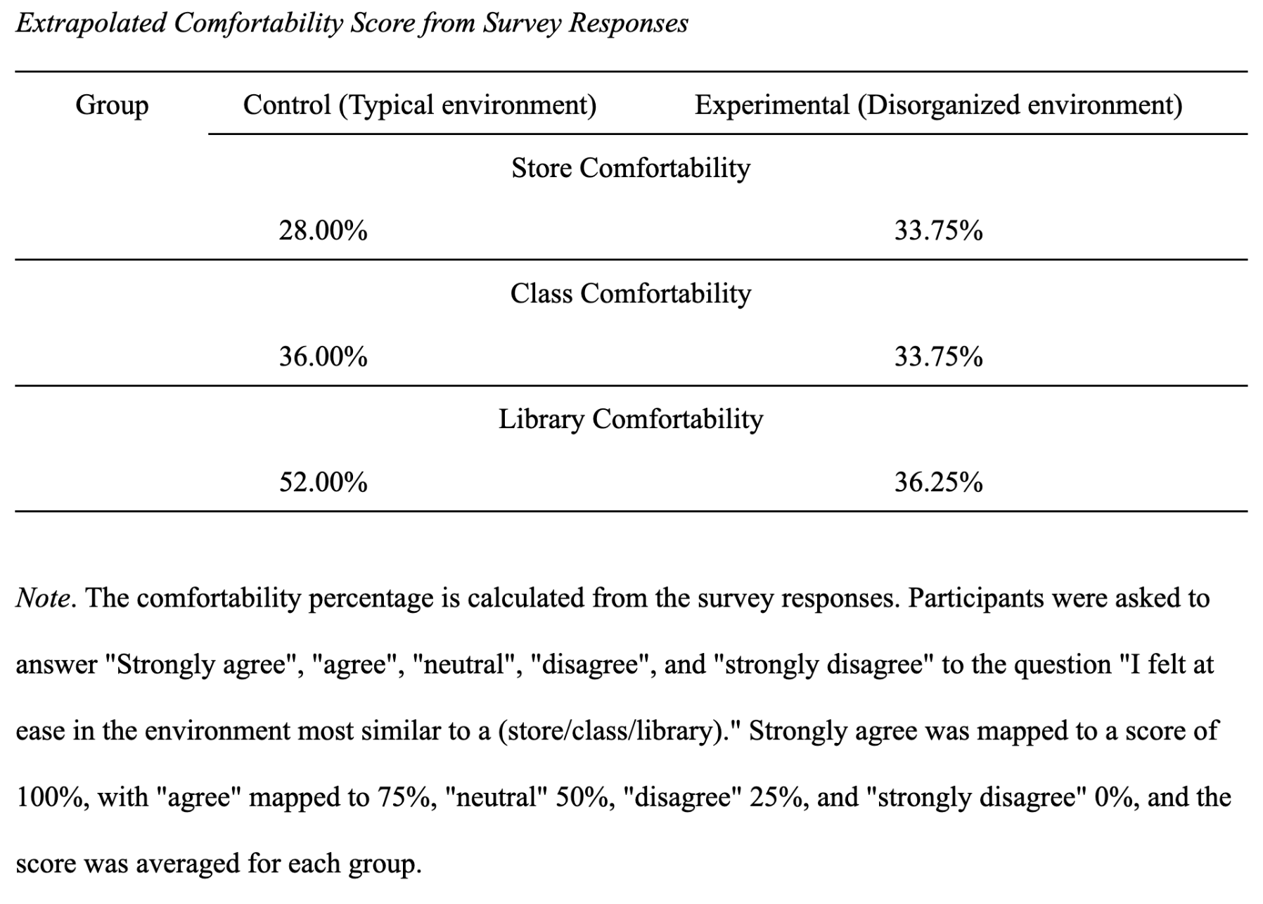

Slide 14
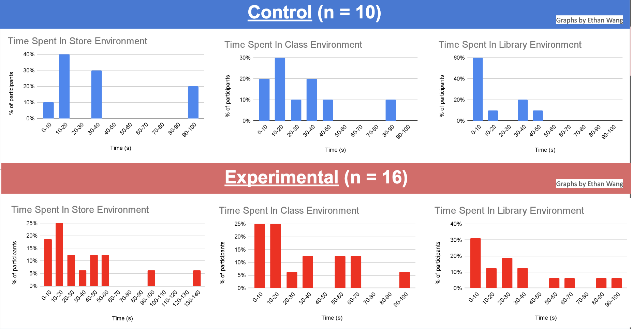

Slide 15
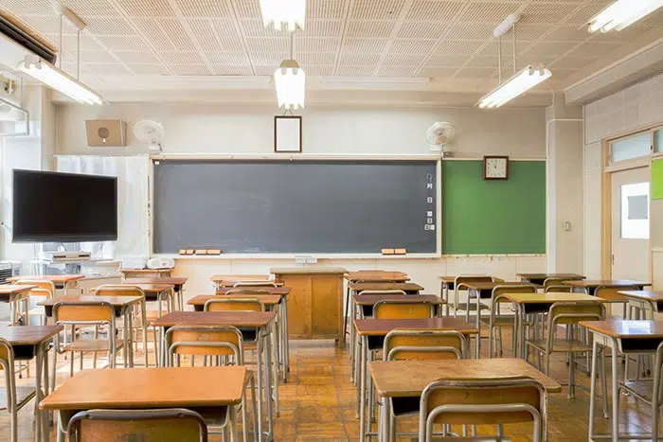

Real World Application
Coming back from COVID-19
Creating optimized spaces
Comfort for students or office workers
Notes:
Talk about optimized spaces commercially, in school, and at home which may increase productivity

Slide 16


What’s Next?
ISTE competition
ISEF presentation playground
Additional avenues of study
Notes:
For Additional Avenues of Study talk about productiveness and maybe space space connection

Slide 17

Thank
You!

Slide 18
References
Aoyagi, S., Fukumori, S., Hirose, K., & Kitamura, T. (2023). Examining the Factors of Place Sameness: A Classroom Re-creation Task in a Virtual Environment (arXiv:2305.04450). arXiv.https://doi.org/10.48550/arXiv.2305.04450
Brookes, J., Warburton, M., Alghadier, M., Mon-Williams, M., & Mushtaq, F. (2020). Studying human behavior with virtual reality: The Unity Experiment Framework. Behavior Research Methods, 52(2), 455–463.https://doi.org/10.3758/s13428-019-01242-0
Cheng, M., Cui, H., Yu, D., & Zhang, Z. (2023). Uncanny Valley Game in Virtual Environments. Highlights in Science, Engineering and Technology, 39, 89–94.https://doi.org/10.54097/hset.v39i.6498
Diel, A., & Lewis, M. (2022). Structural deviations drive an uncanny valley of physical places. Journal of Environmental Psychology, 82, 101844.https://doi.org/10.1016/j.jenvp.2022.101844
Myers, David G. Myers’ Psychology for AP. Worth Publishers, 2014.
Unity - Scripting API: Random. (n.d.). Unity Documentation. Retrieved December 5, 2023, fromhttps://docs.unity3d.com/ScriptReference/Random.html

